Slide 1
Back to basics
Food chain: a representation of the passage of energy across trophic levels (from primary producers through consumers)
  Trophic level: trophic position in the food chain
Food web: a representation of the passage of energy through populations within a community; emphasizes biodiversity

Slide 2
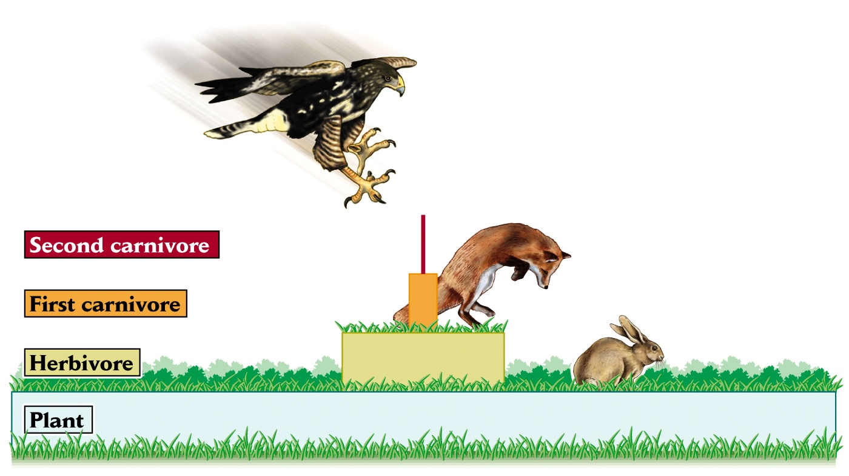
Food chain

Slide 3
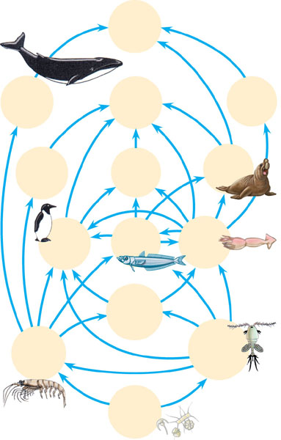
Food web
Humans
Baleen
whales
Smaller toothed
whales
Sperm
whales
Crab-eater seals
Leopard
seals
Elephant
seals
Birds
Fishes
Squids
Carnivorous
plankton
Euphausids
(krill)
Copepods
Phyto-
plankton

Slide 4
Secondary production
Definition
Secondary producers have dual roles as producers and consumers

Slide 5
Ecological efficiency or food chain efficiency
Percentage of energy transferred from one trophic level to the next
Typically between 5-20%
Another way of looking at it is, at each step in the food chain, 80-95% of energy is lost

Slide 6
Components of energy transfer between trophic levels
Energy from lower trophic level
Energy not used
Gross energy intake
Egested energy
Digested energy
Urinary waste
Assimilated energy
Resting energy
Activity
Growth
Reproduction
Maintenance or
respiration
Production

Slide 7
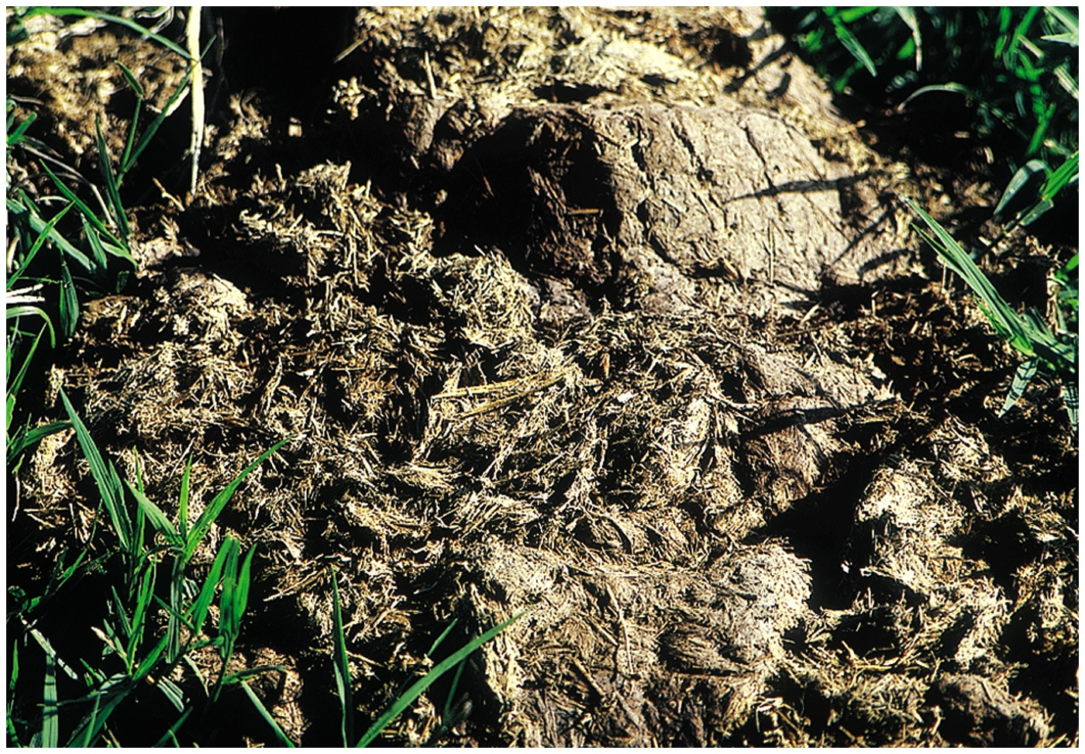
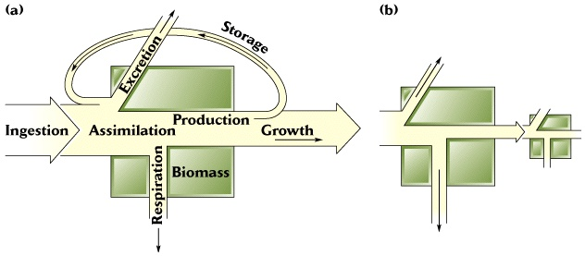
Assimilation =
Production =
Elephant dung
Reproduction
Egested energy

Slide 8
Assimilation efficiency =
Elephant dung
Reproduction
Egested energy
Ranges from 15-90%
Variability due to:
Differences between herbivores/carnivores/decomposers – what are they?

Slide 9
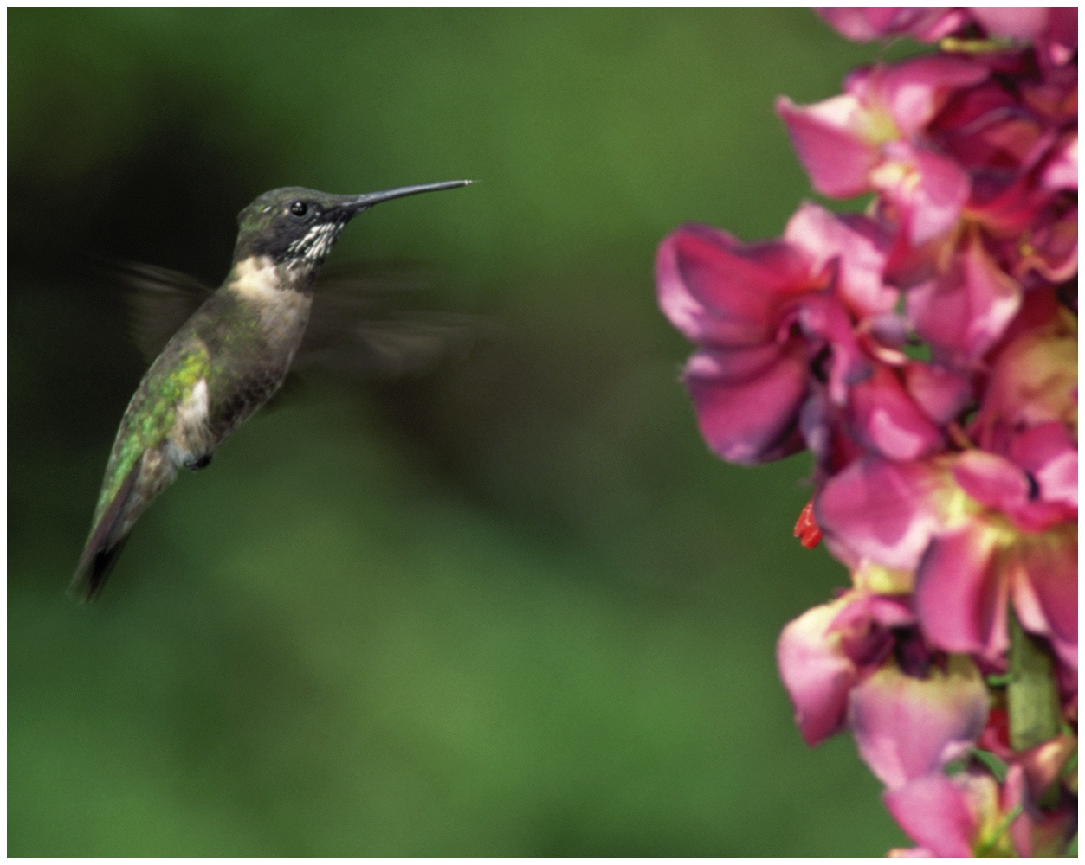
Net production efficiency=
Reproduction
Egested energy
Ranges from 1-6% in homeotherms
Up to 75% in ectothermic poikilotherms

Slide 10
Gross production efficiency=
Reproduction
Egested energy
Ranges from 1-5% in homeotherms
5-15% for insects
Some aquatic animals exceed 30%

Slide 11
Exploitation efficiency
When production and consumption are not balanced → energy accumulates in ecosystem
Exploitation efficiency is the proportion of production on one trophic level that is consumed by organisms in next higher level
Ecological = gross production x exploitation
efficiency efficiency efficiency

Slide 12
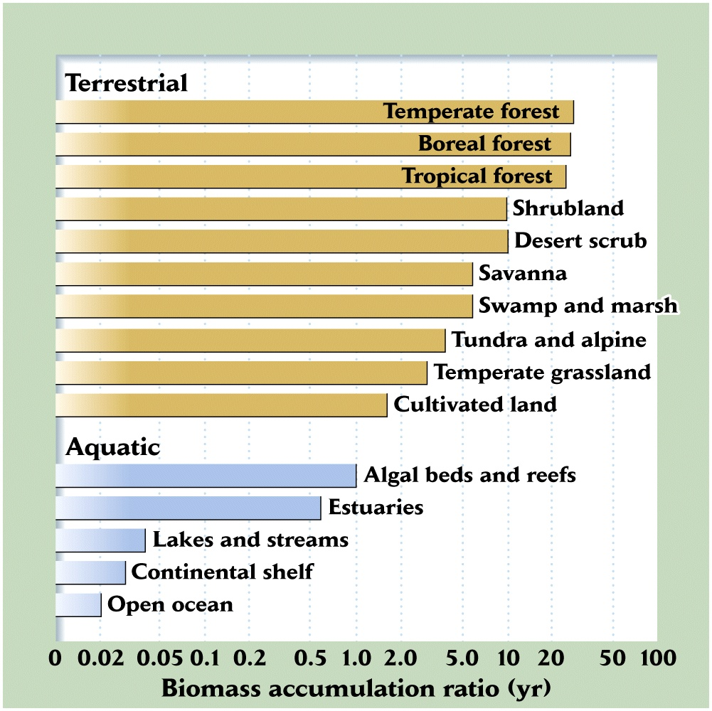
Energy moves through ecosystems at different rates
Residence time
Biomass accumulation ratio
Detritus and residence time
Differences between aquatic
and terrestrial ecosystems

Slide 13
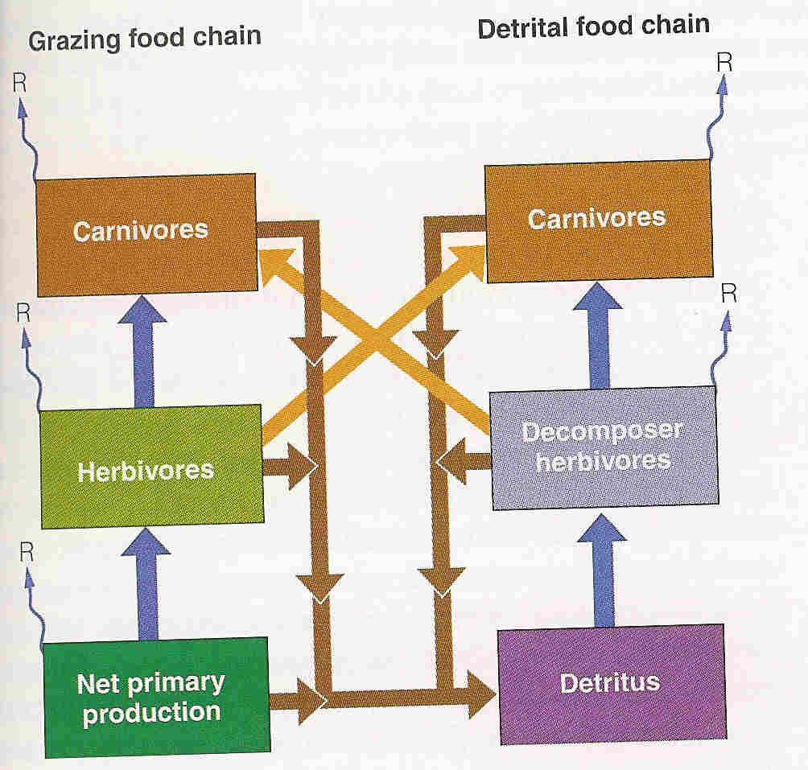
Detritus food chains

Slide 14
Energy as currency
Aids in comparing ecosystems
Helps define connections across ecosystems
Helps define generalities in energy flow

Slide 15
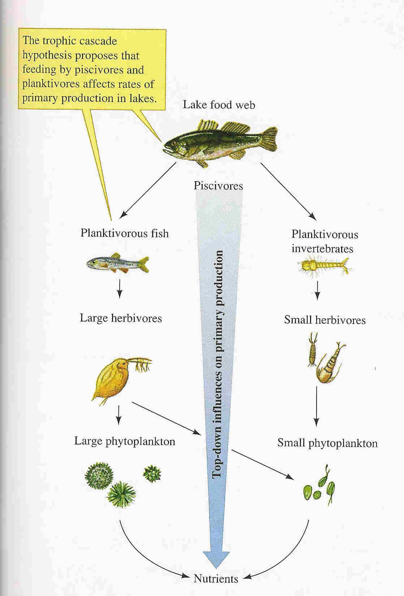
Biotic effects on energy flow

